Slide 1
Database Design

Slide 2
Day 2

Slide 3
Concept of Keys
A key is an attribute or set of attribute that can uniquely identify a record in a table
Keys are also used to establish relationships between the different tables and columns of a relational database.
Types of Keys:
Super Key
Candidate Key
Primary Key
Foreign Key
Alternate Key
Composite Key
Surrogate Key
Natural Key

Slide 4
Concept of Keys
Super Key
A super key is a combination of all possible attributes which can uniquely identify a record in a table.
Attributes can be redundant.
Super key’s attributes can contain NULL values.
Candidate Key
A super key with no redundant attribute is known as candidate key.
All the candidate keys are super keys.
Candidate keys are selected from the set of super keys with no redundant attribute, so also known as minimal super key.
Candidate key’s attributes can also contain NULL values.
Notes:
The role of the super key is simply to identify the tuples of the specified table in the database.

Slide 5
Concept of Keys
Example: Super Key vs Candidate Key
How many super keys the alongside table can have?
{std_id}
{reg_no}
{std_id, reg_no}
{std_id, name}
{std_id, reg_no, name}
{std_id, name}
Selecting candidate keys from the above set of super keys
{std_id}
{reg_no}
std_id | reg_no | name
1 | 3435 | Ram
2 | 9878 | Shyam
3 | 5647 | Hari
Notes:
Why {name} alone is not super key?

Slide 6
Concept of Keys
Primary Key
A primary key is selected from a set of candidate keys.
It is a minimal set of attributes in a table that uniquely identifies records in a table.
A table can only have one primary key and cannot be null
Foreign Key
Foreign keys are the columns of a table that points to the primary key of another table.
More than one foreign keys are allowed in a table.
It can contain duplicate values and a table in a relational database.
It can also contain NULL values.

Slide 7
Concept of Keys
Example: Primary Key and Foreign Key
In the alongside example, Attribute std_id alone is a primary key as each student has a unique id that can identify the student record in the table.
In the alongside example, the std_id column in course_enrollment table is a foreign key as it points to the primary key of the Student table.
std_id | name | age
1 | Ram | 18
2 | Shyam | 19
3 | Hari | 18
course_id | std_id
c1 | 1
c2 | 2
c3 | 1
c5 | 3
Notes:
Why {name} alone is not super key?

Slide 8
Candidate keys: Choosing the right primary key
Fundamentals for choosing a primary key:
Details on uniqueness
The candidate key must be unique within its domain
Details on null values
The candidate key can not hold NULL values
Details on no change
Must hold the same value for a given occurrence of an entity for the lifetime of that entity.
Must be stable.
Details on key value size
Key value can usually be larger
Notes:
Security
Key value can usually be larger, it would have to be duplicated in the referencing table which could take up more disk, and cause slower joins.

Slide 9
Concept of Keys
Alternate Key
After a primary key is chosen from the set of candidate keys, the remaining candidate keys are called alternate keys or secondary keys.
For Example:
There are two candidate keys in the alongside table:
{std_id}
{reg_no}
It is upto DB designer to choose any of the above key as primary key. Let’s say std_id is chosen as primary key.
Since std_id as chosen as primary key, the remaining key reg_no would be called alternative or secondary key.
std_id | reg_no | name
1 | 3435 | Ram
2 | 9878 | Shyam
3 | 5647 | Hari

Slide 10
Concept of Keys
Composite Key
A key that has more than one attributes is known as composite key.
Also known as compound key.
Any key such as super key, primary key, candidate key etc. can be called composite key if it has more than one attributes.
std_id | subject | marks
1 | math | 80
1 | english | 40
2 | science | 55
3 | nepali | 60
3 | science | 90
For Example, in alongside table:
std_id alone cannot become a key as a same student can take multiple subjects.
Based on this, it is safe to assume that the key should be having more than one attributes: Key in the table: {std_id, subject}

Slide 11
Concept of Keys
Natural Key
Keys that have a natural relationship with the rest of the columns in a table.
Has some sort of business meaning
Example: SSN, PAN, Citizenship_no
Surrogate Key
It is a system generated value with no business meaning that is used to uniquely identify a record in a table.
It is generated when a new record is inserted into a table.
For example: In SQL Server, it allows you to define a column with an identity property to help generate surrogate key values.
CREATE TABLE student
(
ID INT IDENTITY (1,1) PRIMARY KEY,
std_name nvarchar(50)
)

Slide 12
Concept of Keys
Natural Key vs Surrogate Key as a primary key.
Natural Keys Pros:
The advantage of natural keys is that they exist already, so no extra space is required for the extra column that would be used by a surrogate key column.
Natural Keys Cons:
Natural keys have business meaning; may need to rework/change key when business requirement change.
Poorer performance since key value can usually be larger, it would have to be duplicated in the referencing table which could take up more disk, and cause slower joins.
Can't enter record until key value is known.
Notes:
Fundamentally, there is no definitive answer as to whether or not you should prefer natural keys over surrogate keys. After all, everyone's requirements are different. What works or performs well in one application might not work so well in another.
For example, if your users decide to make std_id alphanumeric instead of numeric then in addition to updating the schema for the student table you would have to change every single table where std_id is used as a foreign key.

Slide 13
Concept of Keys
Surrogate Keys Pros:
If your business rules change, which would require you to update your natural key this can be done easily without causing a cascade effect across all foreign key relationships.
Surrogate keys are typically ordered integers. Having a small key value means better performance for INSERT/UPDATE operations.
Surrogate Keys Cons:
Extra column for surrogate key will require extra disk space.
Can have duplicate values of natural key in table if there is no other unique constraint defined on the natural key.

Slide 14
Problems with E-R Models:
In E-R models, due to misinterpretation of the meaning of certain relationships, problem known as connection trap results
Connection trap also known as design trap
Two common types of connection trap
Fan Trap
Chasm Trap
Notes:
To identify the connection traps we must ensure that the meaning of a relationship is fully understood and clearly defined

Slide 15
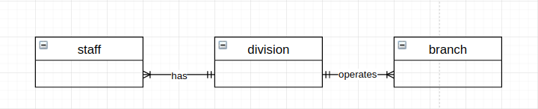
Fan Trap
Fan Trap: A model represents a relationship between entity types but the pathway between certain entity occurrence is ambiguous.
A fan trap may exist where two or more 1:M relationships fan out from the same entity.
The model above represents that a single division operates one or more branches and division has one or more staff.
What happens when we want to know which staff work at a particular branch?
Notes:
Fan out refers to number of outputs from an entity
At which branch does a staff work? We are unable to give a specific answer based on the current structure.
The inability to answer this question specifically is the result of a fan trap associated with the mis representation of the correct relationship between Staff, Division and branch entities.

Slide 16
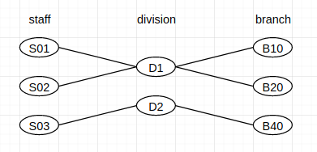
Fan Trap
At which branch does S01 work?
Notes:
We can only determine that staff S01 work in either B10 or B20.

Slide 17
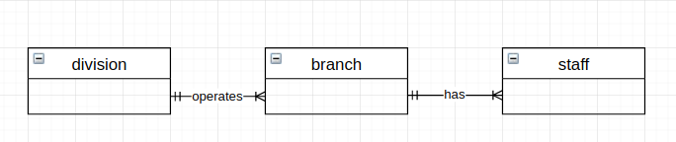
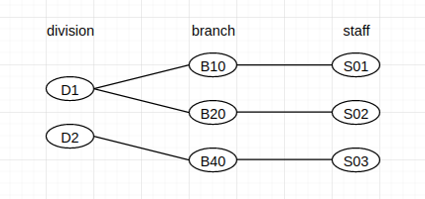
Fan Trap
Fan trap can be resolved by restructuring the original ER model to represent the correct association among the entities.
Notes:
Another solution is to introduce a direct relationship between division and staff entity
This creates an extra relation

Slide 18
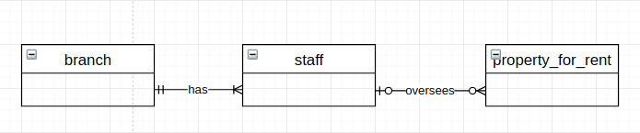
Chasm Trap
Chasm Trap: A model suggests existence of relationship between entity types but the pathway doesn’t exist between certain entity occurrences.
Chasm trap may occur when there are one or more relationships with optional participation forming part of the pathway between related entities.
The model represents that branch has one or more staffs and staff oversee zero or more properties for rent.
Which properties are available at each branch?
Notes:
Not all staff overseas property and not all properties are overseen by a staff
Problem arises when we want to know which properties are available at each branch

Slide 19
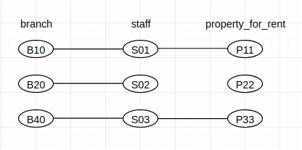
Chasm Trap
At which branch is P22 available?
To solve this problem, missing relationship needs to be identified, which is branch offers property_for_rent.
Notes:
The inability to answer the branch where property is available is considered to be loss of information

Slide 20
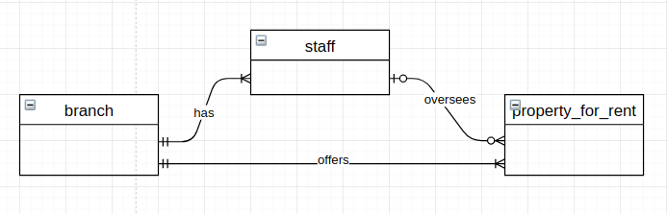
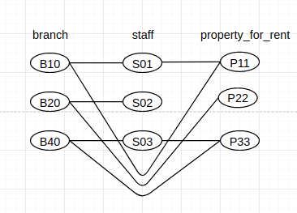
Chasm Trap
Notes:
This model ensures that at all times, properties are associated with branch, including properties that are not yet allocated to a staff.

Slide 21
Conceptual Data Model
Notes:
3 main phases of database design: conceptual, logical and physical
How to use ER modeling to build a local conceptual model based on requirements
How to validate the final conceptual model to ensure that is an accurate representation

Slide 22
Conceptual Data Model
Conceptual Model describes the overall structure of the data model
Serves as the basis for the eventual model that will get implemented
All requirements and documents need to be considered
Ideally, the process of requirements gathering is completed before the start of conceptual modeling
Use conceptual models as a communication device because it has enough structure to show the customer and test that the requirements are met
Conceptual model should be hardware-independent so that the system could be set up with any platform chosen later
Notes:
Process of database design is iterative rather than a sequential process
Conceptual design is independent of all the physical considerations
Creates an abstract database structure that represents the real-word objects in most realistic way possible

Slide 23
Steps in Conceptual Model
Identifying Entities
Entities generally represent people, places, thing, objects
It isn’t critical to categorize entities into specific types but doing so can be useful in identifying patterns of attributes later
Identifying relationships between entities
Find how each of entities will work with one another
Notes:
First step in building a conceptual model is to determine and define the main objects that the users are interested in
Objects are entity types for the model
Identify nouns from the requirements specification
Look for objects that have an existence
Sometimes difficult to identify entities because of the way they are presented, users often talk in terms of examples
Similar to nouns, relationships can be often identified by the verbs
Interested only in required relationships, as there might be multiple possible relationships

Slide 24
Example Scenario
I want to create a music streaming service where users can sign up for free. Users can listen to the songs that are uploaded by the artists. Users can create multiple playlists and each playlist can have multiple numbers of songs. A playlist can only be owned by a single user. An artist can either have a single release or have an album containing several songs. A song could only appear in one album. Songs can be categorized based on their genre.
Users need to be able to save its preferences such as language, theme while using the service.

Slide 25
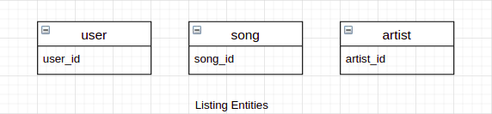
Conceptual Modeling for Example Scenario
Identifying Entities
user
artist
playlist
song
album
genre
user_settings

Slide 26
Defining Business Rules
Business rules are the statement that imposes some form of constraint on a specific aspect of database such as characteristics of a given relationship
Each organization has its own data and information requirements and each has its unique way of conducting business
As a result, every organization needs its own specific set of business rules
Example:
user can create multiple playlist
playlist can have only one user
song can appear only in an album or not have album at all
Notes:
Pros of well defined business rules
Help to understand the business process
Help to understand the nature, scope and role of data

Slide 27
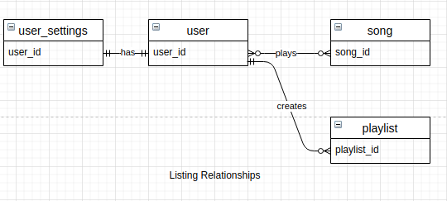
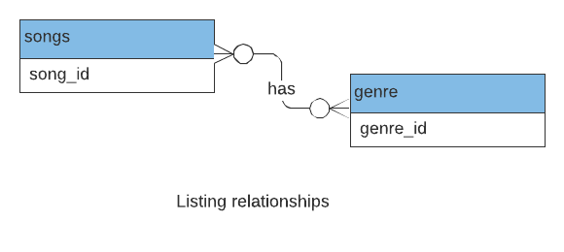
Conceptual Modeling for Example Scenario
Identifying Relationship between entities
user has playlist
user plays song
user can follow artist
artist has song
artist can have album
playlist, album has song
song has genre
user has user_settings
Notes:
Use ER diagrams as it is often easier to visualize a complex system
Having identified the relationships, determine the multiplicity of each relationship
Check for upper and lower bounds
Check for design traps
Identifying relationships and business rules often take place in parallel and the process is iterative

Slide 28
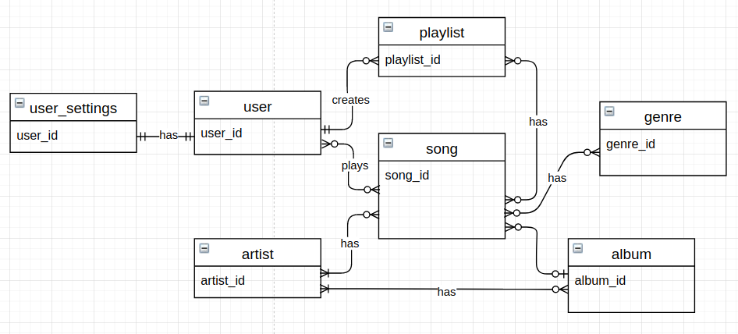
Example Scenario: Final Conceptual Model
Notes:
Conceptual Model verification is the final step
Create an instance and check the relations, and ensure whether the information required is met by model
Some of the entities and relationships might have been omitted, in this case, return to the previous steps
Can have identified several entities that could be represented as a single entity eg. manager and users
Advanced ER modeling, such as generalization, specialization

Slide 29
Assignment
Create conceptual modeling for the domain that you have collected the requirements.
Additional Task: We will be pairing interns with each other. Now your task is to design the model for your friend’s requirements. As a client, you can specify the business rules.
Notes:
Documentation on the relationships.

